Slide 1


SAP S/4HANA CDS, SAC Training Day 13
Anubhav Oberoy

Slide 2
Agenda – Day 13
Integration Basics
SAP Cloud Connector
SAP HANA Integration

Slide 3
Why integration?
Most of the time, our data is not available in excel. It is stored inside a system.
e.g. HANA (Database), BW, S/4HANA, BPC, other…
SAP Analytics cloud
source system
data
There are 2 types of data sources supported by SAC
Acquire Data Source – all the data will be copied from the source system and store it in sac.
Live Data Source – Data is never stored in SAC, rather it will be fetched at runtime. Any change to data in underlaying source system will immediately reflect in SAC. (limited types of source). So when we create model in sap analytics cloud, you will only see the skeleton of the data.
SAP HANA
SAP BW
SAP S.4HANA
SAP BPC

Slide 4
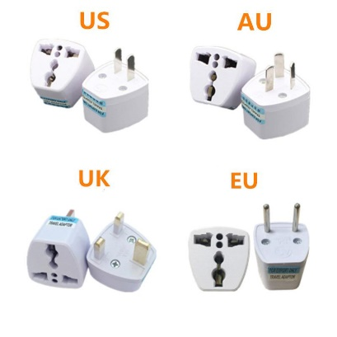
Internet
On-premise
SAP Analytics Cloud
SCC
SAP S/4HANA System
/bc/bw/ina
VPN
Laptop
Cloud System
Success Factor - HRMS
Ariba - SRM
Adapter
Field glass - Contractor
Concur – Travel & Expese
HANA Cloud – FREE TRIAL
Internet

Slide 5
3
2
SAP Analytics Cloud
Adaptor
1
Create HANA Cloud
BAS – Native HANA db objects connects to HANA DB
Deploy – Table, TF, Calc View, CUBE
SAP HANA Cloud

Slide 6




















hplhana

Slide 7





















Slide 8

Odata Connection
ODataConnection.executeAction("Flight/Book",{
Flight: {
Airline: 'AA',
Flightconnection: '0017',
Flightdate: FLDate
},
NumberOfSeats: 1
});
Application.refreshData();
ODataConnection.executeAction("CancelMyFlights",{
DateFrom: '2020-01-01',
DateTo: '2022-01-01'
});
Application.refreshData();
www.anubhavtrainings.com

Slide 9






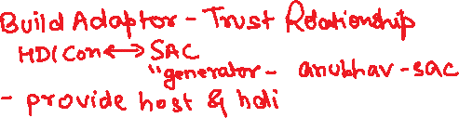





Live Data Conn. With SAP HANA DB in Cloud
SAP Analytics Cloud
(Client)
HANA Consultants
SAP HANA Service
Adaptor
MTA App
www.anubhavtrainings.com

Slide 10
HANA Live Integration with SAC
HANA Native Development (HANA Consultant – SAP WebIDE for HANA Dev)
HANA Instance needs to be started in SCP
Connect to WebIDE, create a new HANA DB Module
Maintain the service-name as some name inside the mta.yml → sac-hdi
Go to SRC folder inside DB folder and create
A DB table, - an csv file - an hditable - calculation view of type CUBE
Build the module and check the container
2. HANA Adaptor for secure connection to container in HANA (SAP Business App Studio)
Create a new dev workspace
Open workspace projects
Open terminal and type command npm install generator-anubhav-sac
Call yo command and provide container name from step 1 and SAC host url w/o http upto .sap
You will see a project created in bas, navigate to srv/target folder of that project
www.anubhavtrainings.com

Slide 11
Continue….
Go to sap tools for hana and download the xsahaa-release-1.6.1-release.zip (sha1)
Extract in computer and upload the war file to the folder
Right click to mta.yml file in the adaptor project and click Build MTA
If the build is success we see an mta_archieve with mtar extension.
Right click on MTAR file generated by system and say deploy to CF
Go to CF and Applications inside your dev space
Ideally an app with same name must be up and running
Once the app is deployed, we need to grant auth to our user to access this app
Go to role collection in our trial a/c search for app_Viewer role collection
Click and edit and assign to your email id and Save
Test the adaptor service by adding /sap/bc/ina/service/v2/HeartBeat
3. SAC Live Connection
Add live data connection with HANA of Direct Type
Provide Adaptor URL and enter CF credentials.
www.anubhavtrainings.com

Slide 12

Questions?

Slide 13


Thank you
Anubhav.abap@gmail.com
contact@anubhavtrainings.com
+91 84484 54549
www.anubhavtrainings.com

